Slide 1
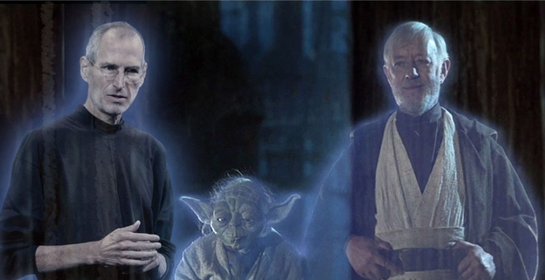
Personal Branding
By Rob Kelly

Slide 2
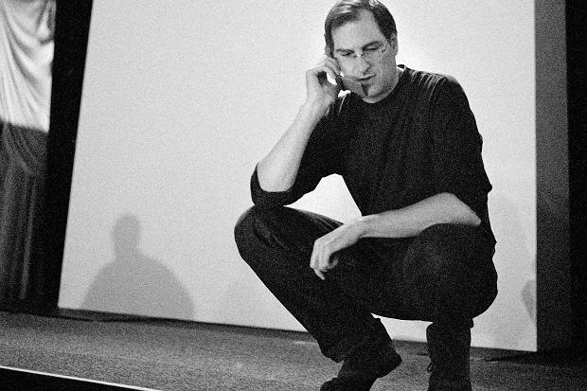

Slide 3
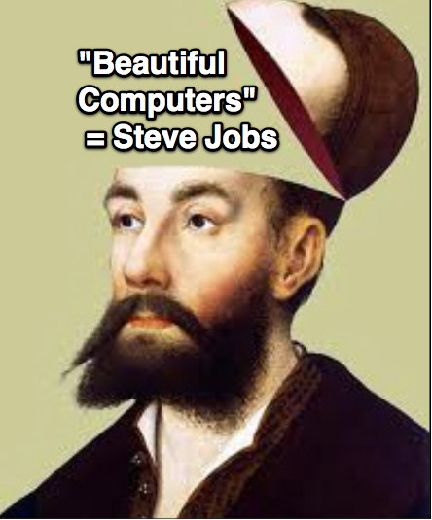
#1 Owning The Brain

Slide 4
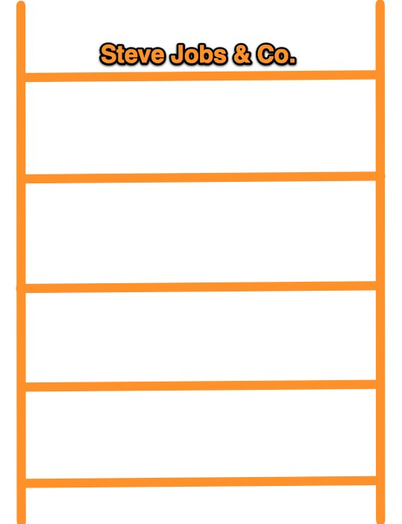
No One Owned
“Beautiful Computers” in my Brain

Slide 5
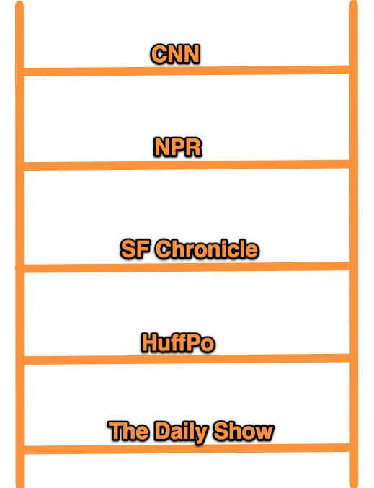
The Ladder in my Brain for “News”

Slide 6
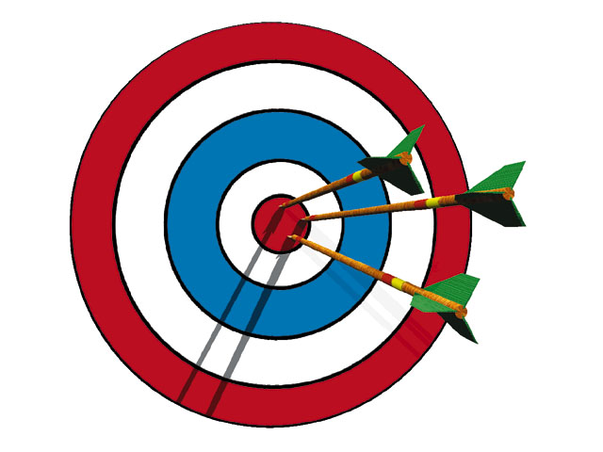
#2 Specificity

Slide 7

(7 Billion people / 12,000 words
= 583,000 people per word

Slide 9
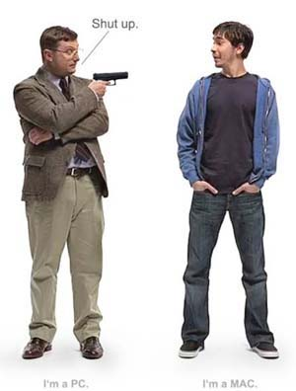
“Alienate The Non-Prospect”

Slide 10
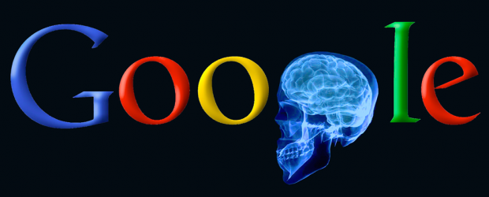
Think like…

Slide 11
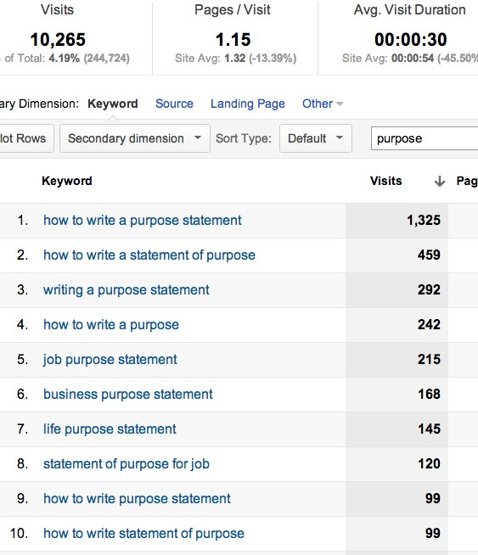
10,000 People Want “Purpose”

Slide 12
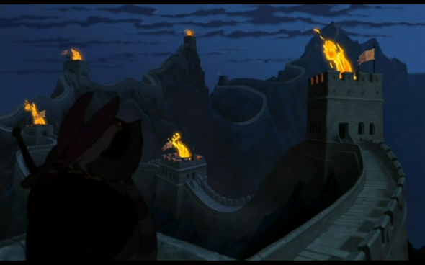
#3 Beacons
Notes:
The beacons connecting Gondor to Rhohan in Lord of The Rings

Slide 13
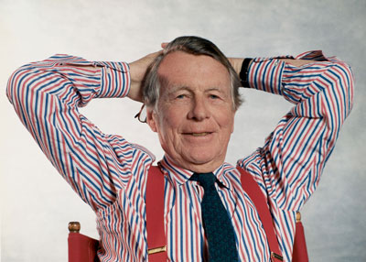
“The more you tell, the more you sell”
-- Ad Guru David Oglivy

Slide 14
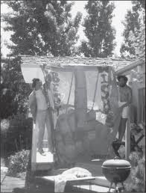
Be Yourself

Slide 15
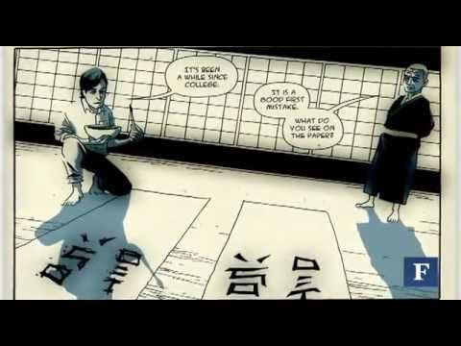
Find Yourself

Slide 16
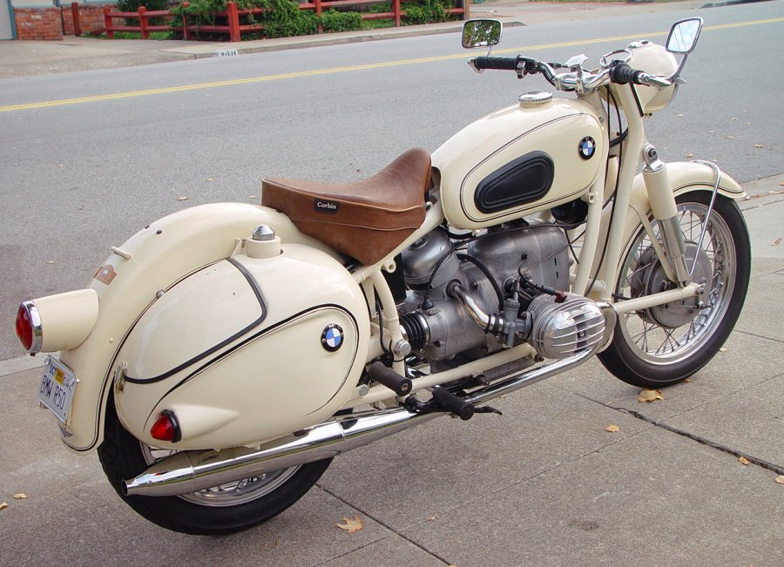
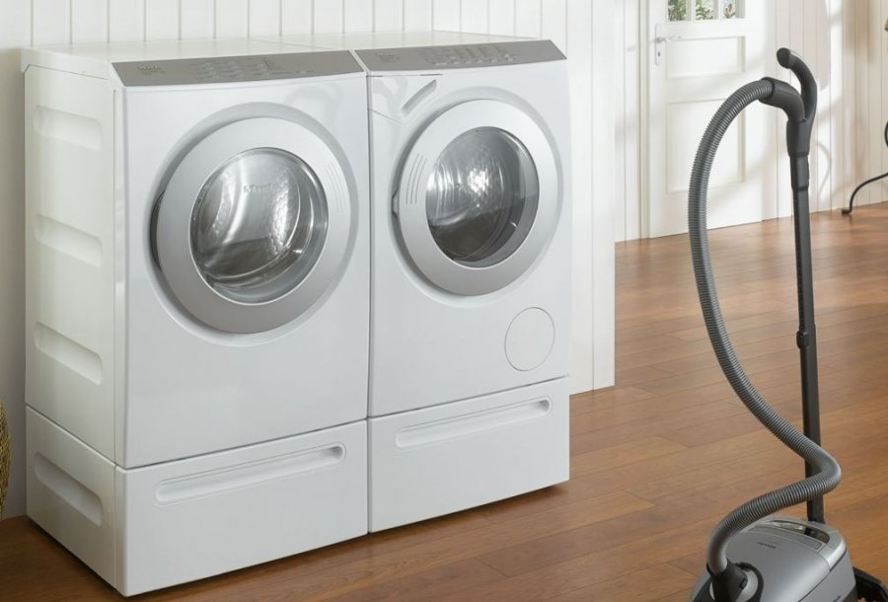
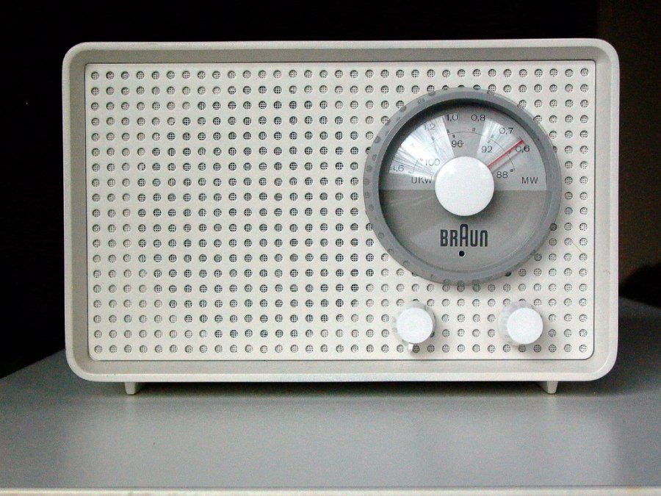
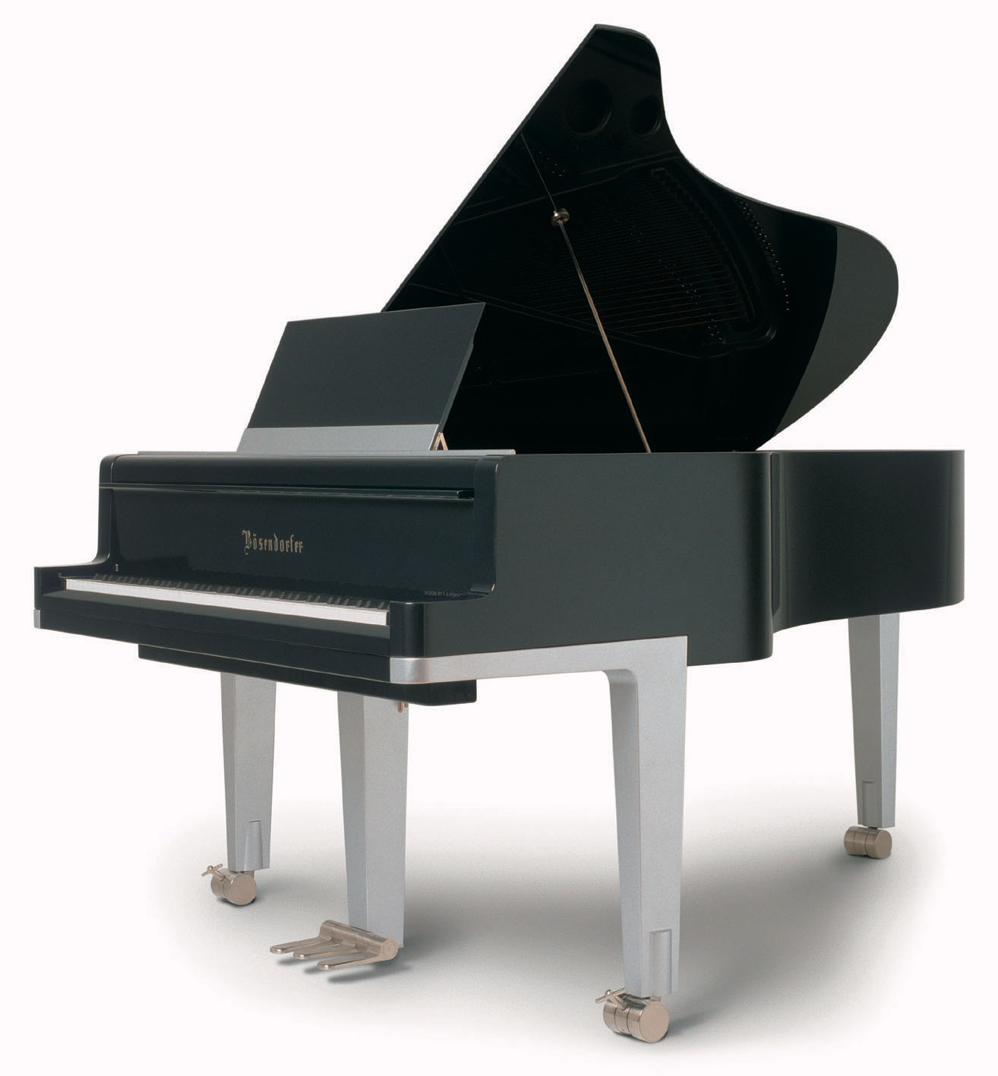
Share Yourself
Notes:
Meelay washer dryer

Slide 17
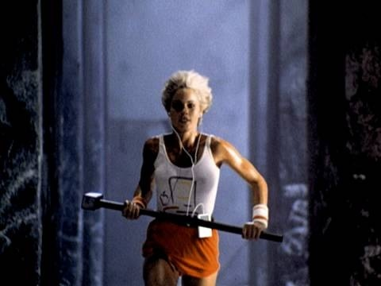

Slide 18
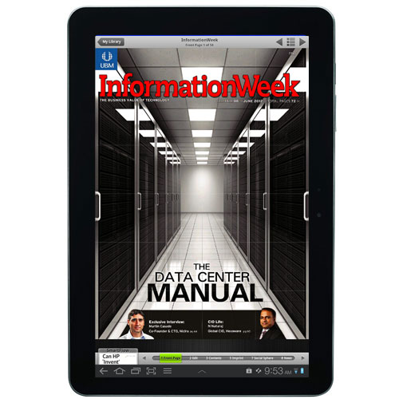
It worked…and I told 300,000 people

Slide 19
Exercises for
Brain, Specificity & Beacons

Slide 20
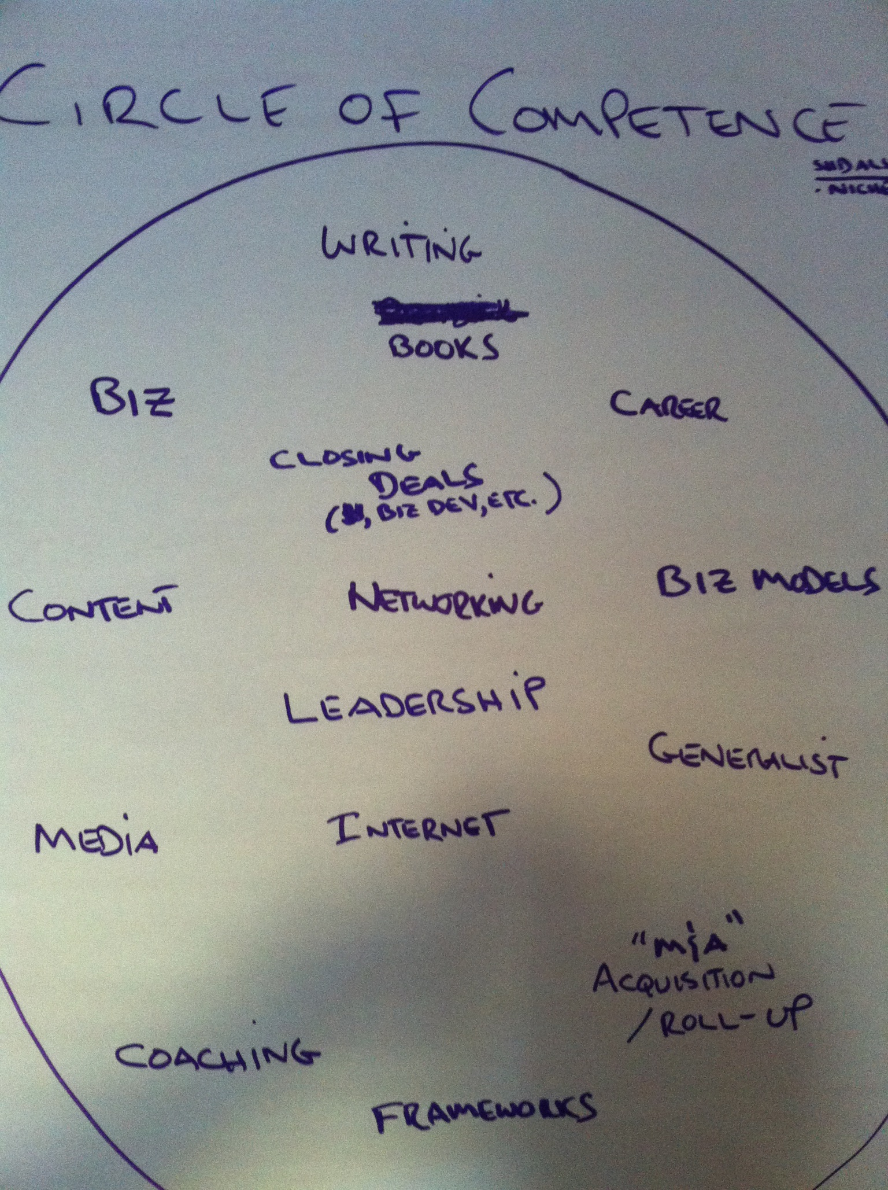
Circle of Competence

Slide 21
Explore Your Purpose & Passion

Slide 22

Pick a Ladder on Which
You Are the Top Rung

Slide 23
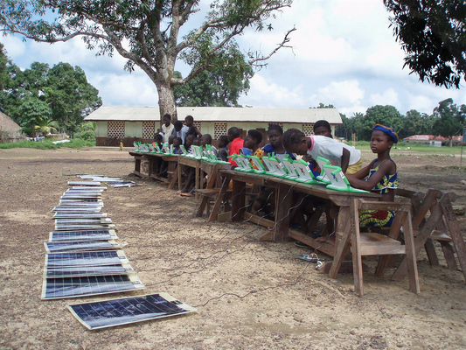
Green Computers?
Notes:
Need a story here or metaphor/analogy

Slide 24
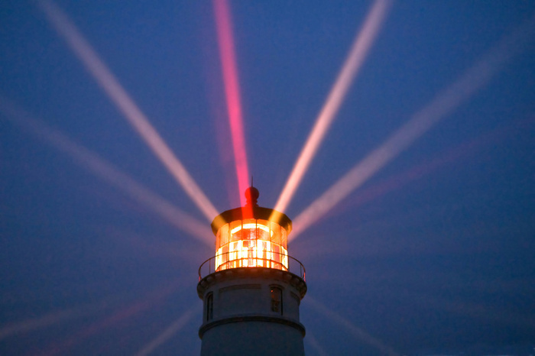
“The more you tell, the more you sell!”

Slide 25


Slide 26
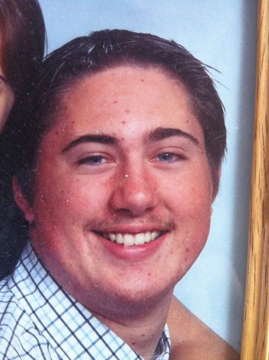
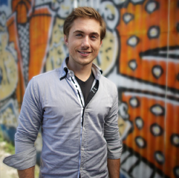
Blog + Brian Kerr = AMA Speech

Slide 27
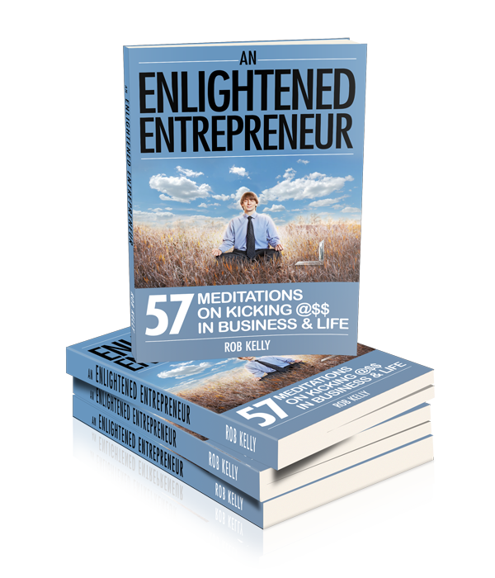
A book as a 200-page business card

Slide 28
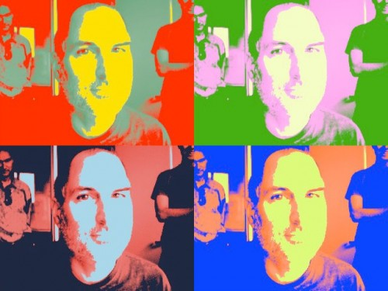
Thank You!

